Slide 1
OutReach (ORN)
Venture Capital Analysis
Jacob Baron, Ben Hoffman, Reid Zuerlein, Lucas Lantis

Slide 2
Overview of OutReach Networks (ORN)
ORN sells wireless networking products to rural and remote areas with little internet access, “The Last Mile”
Commodity hardware combined with proprietary software
ORN has been profitable since founded in 2007
Indirect sales model → lean workforce
Simple product design → less investment in property and equipment
Tremendous room for growth
75% of the world’s population does not currently have internet access
Only 9% of revenues came from Asia → untapped market with high profit potential

Slide 3
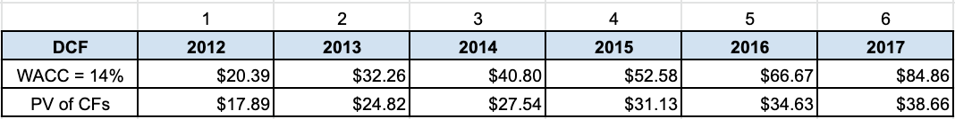
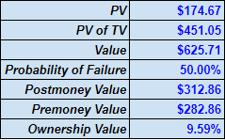
DCF Valuation
Found the cost of equity to be 14% by using the CAPM approach.
(Risk-free Rate + Beta X Market Premium)
(5% + 1.5 X 6%) = 14%
Discounted the FCFs to find a PV of $625.71 million including terminal value.
Reduced the valuation by 50% due to the high probability of startup firms failing in their early years.
Ownership value after the investment is 9.59%.

Slide 4
Venture Capital Valuation
P/E calculated by averaging the P/Es of several comparable public firms of different sizes
14.3% equity stake is required in exchange for their investment
Half of the requested 40% ownership from Everest Partners
Suggests a postmoney valuation for OutReach Networks of $208.4 million
This is the terminal value of ORN at Everest’s estimated exit point. At this point in time their stake would either be sold back to current ownership, new investors, or held for more time.

Slide 5
Is $30 Million for 30% Fair?
30% is too high
Everest Partners used a very conservative P/E ratio of 10 (P/E of Cisco Systems) to value ORN at just $98 million
Industry average P/E is 21.8
Valuation is overly conservative based on ORN’s past performance which is not typical of a startup organization
Proven profitability from the beginning
Lean workforce with low overhead costs → ORN has the means to expand without investment
Using the industry average P/E of 21.8:
Post-Money valuation of $208.5 million
Required equity stake of 14.4%, inline with Mr. Perez’s calculations
Far less conservative P/E is of better use for such a profitable and successful startup like ORN

Slide 6
Recommendation
Do not accept the offer of $30 million for 30% of ORN
Everest Partner’s is far too conservative in their calculations
Only one comparable organization had a P/E ratio of less than 20 (Cisco systems: 10.3x)
Industry average P/E is 21.8
Conservative P/E ratio should not be used on such a successful and atypical startup
With already tremendously low costs, investment isn’t necessarily required for success
Based on DCF valuation, $30 million is worth 9.59% of the company
While the $30 million investment would allow for ORN to grow at a faster pace, Everest is asking for too large of a stake in the company for it to be the best decision for current ownership

